Slide 1
The Other Languages
Don’t panic!
https://github.com/JimWright4089/FIRSTWorkshops

Slide 2
Intro
Things covered in this class:
Microsoft MakeCode
CMU RobotC

Slide 3
Microsoft/Lego MakeCode
https://makecode.mindstorms.com/
Collaboration between Lego and Microsoft.
Has Lots of Examples

Slide 4
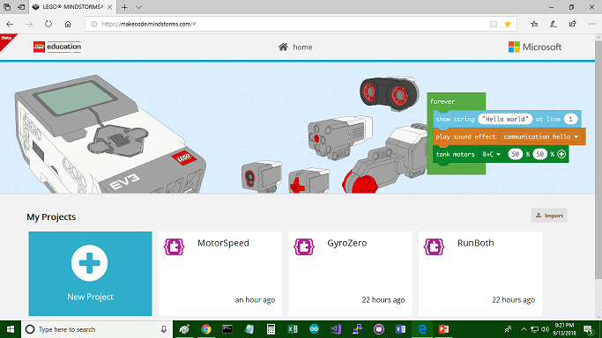
Microsoft MakeCode

Slide 5
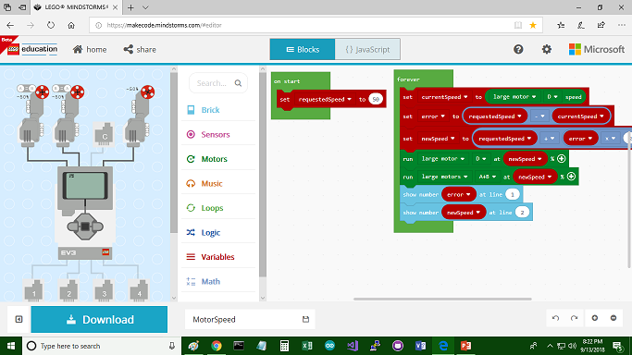
Microsoft MakeCode

Slide 6
Needs a browser, and Internet connection?
Will it work without an Internet connection?
Yes!
It’s a HTML5 app that can run without a connection

Slide 7
The Wire Digram takes up too much space
You can hide it.
New programs use the same name as Arduino Programs

Slide 8
First Program, go forward 1 second
Drag and drop in interface.
For this program click on the Green Motors menu.
Tank motors move two motors at a time.
Select the two motors, and the speed of the motors.
Remember to stop motors.

Slide 9
Wait, what is that button!
Notice the Javascript button.
Here is the blocks in Javascript

Slide 10
Downloading to EV3
Before downloading works you need to put LME-EV3_Firmware_1.10E.bin on the brick.
Follow the instructions on the site to get the file.
I used the old LEGO EV3 software to reflash the EV3 brick.

Slide 11
Downloading to EV3
The new firmware has put a drive on your computer. Projects hold the compiled program.

Slide 12
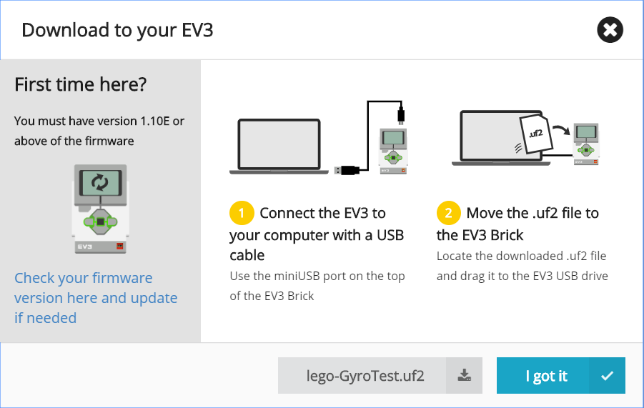
Downloading to EV3
Hitting download will put the file in your Download directory.
However, on this panel, right click on lego-GyroTest.uf2 and click Save As…
You will hear the EV3 reboot

Slide 13
Functions

Slide 14
Functions

Slide 15
Gyro Angle not working
I showed this example last year and it worked.
So I put the code on and was going to have a video of it.
Three hours later and a lot of Google searches, and the Gyro Angle is not working in this version.

Slide 16
The Help is brilliant

Slide 17
RobotC
It was my favorite language for the EV3.
It is C based.
It cost money.
If you learn it, you can program NXT and VEX robots.

Slide 18
RobotC
Like MakeCode, it also has a version of the firmware that it needs.
The IDE has an option to put the firmware on.
When you run the program it handles downloading and starting

Slide 19
RobotC
It is standard C, with #prama statements it links up the hardware to variables.
#pragma config(Sensor, S4, Gyro, sensorEV3_Gyro)
#pragma config(Motor, motorC, motorLeft, tmotorEV3_Large, PIDControl, driveLeft, encoder)
#pragma config(Motor, motorD, gerald, tmotorEV3_Large, PIDControl, driveRight, encoder)

Slide 20
RobotC
int angle = DeadBand(SensorValue[Gyro]);
if(0 == angle)
{
motor[motorLeft] = 0;
motor[gerald] = 0;
}

Slide 21
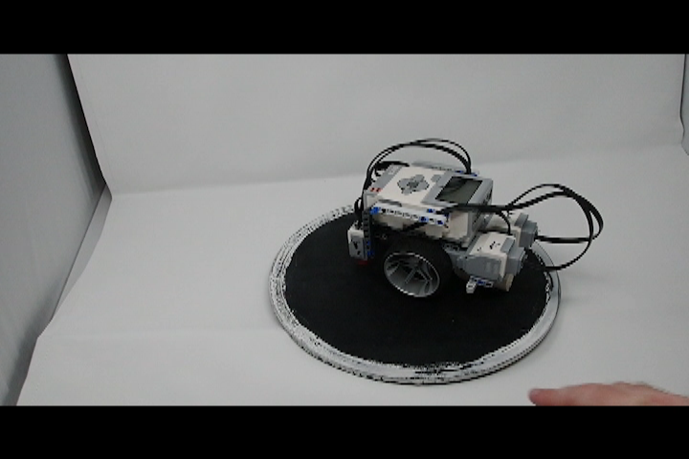
RobotC

Slide 22
Fin’
Our revels now are ended. These our actors,
As I foretold you, were all spirits and
Are melted into air, into thin air:
And, like the baseless fabric of this vision,

